Slide 1
What is Engineering?
tomorrowsengineers.org.uk

Slide 2
What is
Engineering?
Notes:
Ask the students.
What is Engineering?
Allow time for the student contribution.
Click (Next slide):

Slide 3
STEM
Science, Technology,
Engineering and Maths.
Notes:
Explain to the students that engineering is the creative practical problem solving part of STEM.
Click:
Science, technology, engineering and maths.
Click (Next slide):

Slide 4
What does an
Engineer do?
Notes:
Ask the students.
What does an Engineer do?
Allow time for the student contribution.
Click (Next slide):

Slide 5
Engineers make a
positive difference
to the world.
Notes:
Engineers make a positive difference to the world such as maintaining clean energy supplies.
Click (Next slide):

Slide 6
Engineers use their skills and knowledge.
Engineers design and create new things.
Notes:
Engineers use their skills and knowledge to design and create things and improve the way things work.
Click (Next slide):

Slide 7
Engineers use their
knowledge and
understanding.
Notes:
Engineers use their knowledge and understanding.
Engineers need to use science, maths, design and technology, and computing in a creative and practical way.
Click (Next slide):

Slide 8
Engineers are
reality makers.
Notes:
Engineers take ideas and turn them into reality.
Click (Next slide):

Slide 9
This is Engineering
Notes:
Task (1.30 mins): Play the “This is Engineering” film.
Film should play automatically - if film doesn't play just click on the centre of the screen.
Click (Next slide):

Slide 10
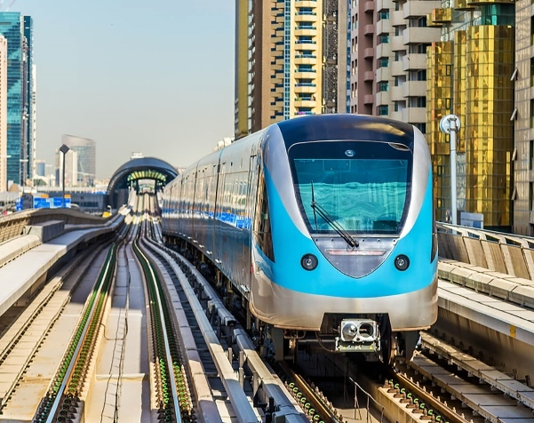
So what is an
Engineer?
Notes:
So what is an Engineer?
Outline that an engineer is someone who works with others to design, create or improve a product, a way of doing something, or part of our environment. They also explain that engineers are trained in a practical way, using maths and science and other subjects like design & technology, art and computing, to creatively solve problems in a specific branch of engineering. We’re going to look at different kinds of engineering today. Briefly run through the following slide if necessary.
Click (Next slide):

Slide 11
Activity time:
Notes:
You're now ready to complete the activities in Part 1, “What is Engineering” of the online Energy Quest programme.
.

Slide 12
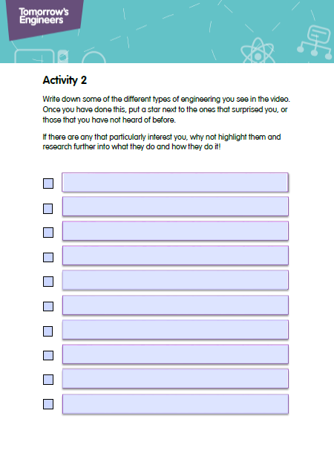
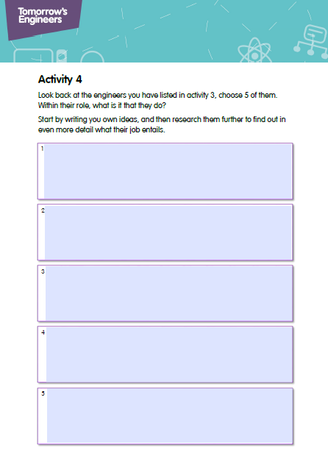
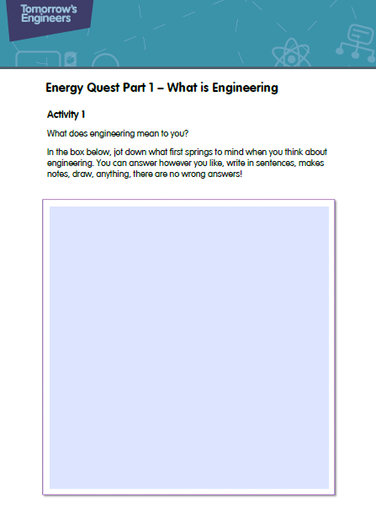
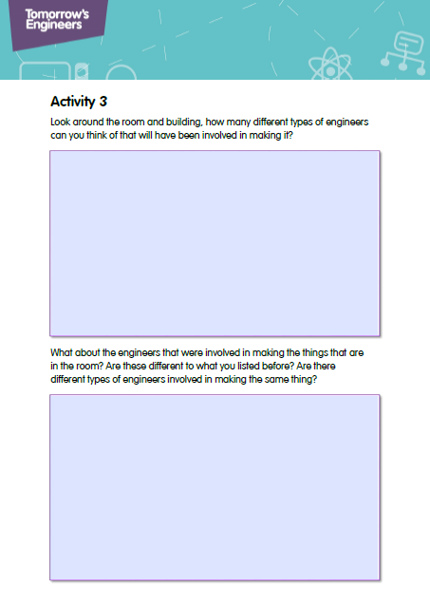
Notes:
You're now ready to complete the activities in Part 1, “What is Engineering” of the online Energy Quest programme.
You will need to distribute activity sheets 1,2,3 and 4.
Pens and pencils will be required for these activities.

