Slide 1
Why do We Need Engineers?
tomorrowsengineers.org.uk
Notes:
Click (Next slide):

Slide 2
Why do We
Need Engineers?
Notes:
Ask the students.
Why do We Need Engineers?
Allow time for the student contribution.
Click (Next slide):

Slide 3
Engineers
make it possible
for people to live
more easily and
comfortably.
Notes:
What binds all engineers together is what they do. It is remarkably similar across all branches and disciplines of engineering. And it is humanitarian at its core.
Engineering makes it possible for people to live more easily and comfortably because we enable people to do more, with greater certainty, less effort, less consumption of material resources and less energy. All that adds up to less cost, in any system of economics.
Click (Next slide):

Slide 4
Engineers
enable people to
do more, with
greater confidence,
Notes:
What binds all engineers together is what they do. It is remarkably similar across all branches and disciplines of engineering. And it is humanitarian at its core.
Engineering makes it possible for people to live more easily and comfortably because we enable people to do more, with greater certainty, less effort, less consumption of material resources and less energy. All that adds up to less cost, in any system of economics.
Click (Next slide):

Slide 5
less effort, less
consumption of
material resources
and less energy.
Notes:
What binds all engineers together is what they do. It is remarkably similar across all branches and disciplines of engineering. And it is humanitarian at its core.
Engineering makes it possible for people to live more easily and comfortably because we enable people to do more, with greater certainty, less effort, less consumption of material resources and less energy. All that adds up to less cost, in any system of economics.
Click (Next slide):

Slide 6
The Future Energy Mix
Notes:
Task (3 mins): Play The Future Energy Mix film about our world, and the future energy challenges/opportunities
Film should play automatically - if film doesn't play just click on the centre of the screen.
Click (Next slide):

Slide 7
Activity time:
Notes:
You're now ready to complete the activities in Part 2, Why do We Need Engineers? of the Online Energy Quest programme.
Click (Next slide):

Slide 8
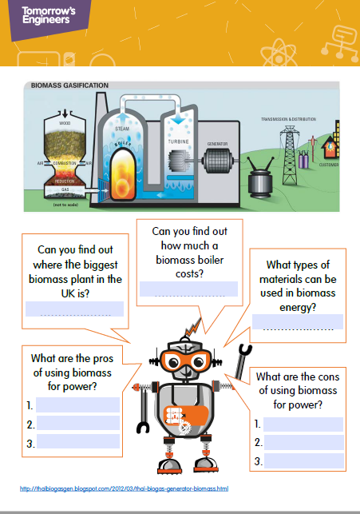
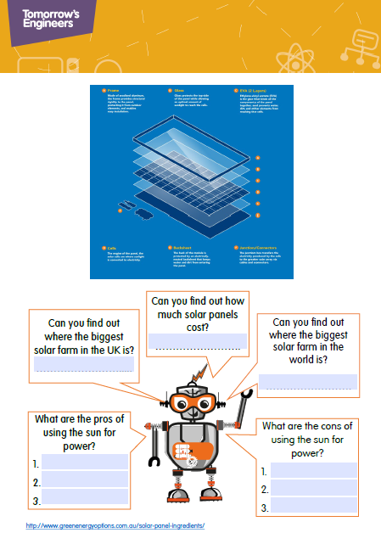
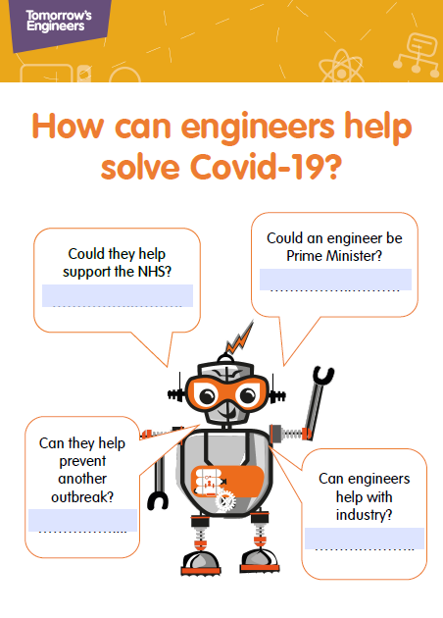
Notes:
Activity sheets linked to this film, research a range of different engineering solutions that are required to meet some of the world’s problems.
You're now ready to complete the activities in Part 1 “What is Engineering” of the online Energy Quest programme.
Pens and pencils will be required for these activities.
Click (Next slide):

Slide 9
Staying Safe Online
There are lots of fun and interesting things you can do on the internet.
Tips to Stay Safe Online
Think before you post.
Don’t share personal details.
Watch out for phishing and scams.
Think about who you’re talking to.
Think about what you’re looking at.
Keep your device secure.
Never give out your password.
Cover your webcam.
Notes:
Staying safe online
It’s not always easy to know what’s safe online and what’s not.
There are lots of fun and interesting things you can do on the internet. And it can be a great way to stay in touch with friends. But it’s important to understand how to stay safe online.
Sometimes people will try to trick you into clicking dangerous links or sharing things about yourself. Or something you’ve shared might be used to bully or frighten you.
Tips to stay safe online
There are lots of things you can do to keep yourself safe online.
Think before you post Don’t upload or share anything you wouldn’t want your parents, carers, teachers or future employers seeing. Once you post something, you lose control of it, especially if someone else screenshots or shares it.
Don’t share personal details Keep things like your address, phone number, full name, school and date of birth private, and check what people can see in your privacy settings. Remember that people can use small clues like a school logo in a photo to find out a lot about you.
Watch out for phishing and scams Phishing is when someone tries to trick you into giving them information, like your password. Someone might also try to trick you by saying they can make you famous or that they’re from a talent agency. Never click links from emails or messages that ask you to log in or share your details, even if you think they might be genuine. If you’re asked to log into a website, go to the app or site directly instead.
Think about who you’re talking to There are lots of ways that people try to trick you into trusting them online. Even if you like and trust someone you’ve met online, never share personal information with them like your address, full name, or where you go to school. Find out more about grooming.
Keep your device secure Make sure that you’re keeping your information and device secure.
Never give out your password You should never give out your password or log-in information. Make sure you pick strong, easy to remember passwords.
Cover your webcam Some viruses will let someone access your webcam without you knowing, so make sure you cover your webcam whenever you’re not using it.

Slide 10
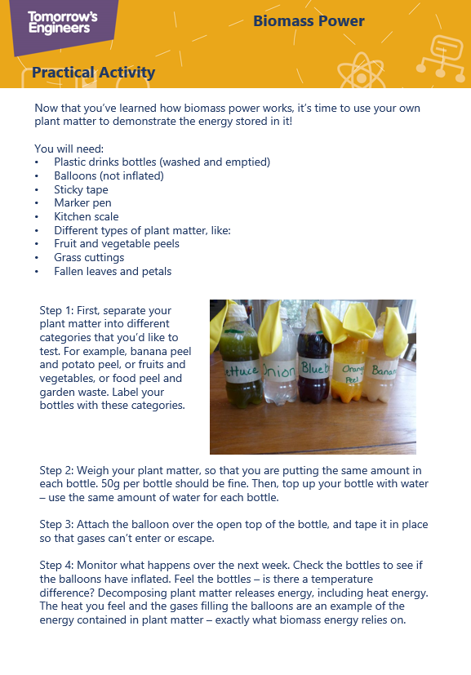
Practical Activity
Notes:
Practical Activity
Click (Next slide):

