Slide 1
Understand Stores of Energy
Section 1.
tomorrowsengineers.org.uk
Notes:
Understand Stores of Energy Section 1
Click (Next slide):

Slide 2
What is
Energy?
Notes:
Ask the students What is Energy?
Allow students time to respond.
Click (Next slide):

Slide 3
Energy is the
ability to do
work.
Notes:
Explain to the students that energy is the ability to do work.
Click (Next slide):

Slide 4
We can describe
energy as being
in different ‘stores’.
Notes:
Introduce to the students that we can describe energy as being in different stores.
Energy is represented as the store of the potential to do work.
Click (Next slide):

Slide 5
Stores of the
ability to do
work.
Notes:
Explain that there are lots of ways to store energy to store the potential to do work.
Energy can be stored or transferred but cannot be used up as that store of energy is not actually a physical thing.
Click (Next slide):

Slide 6
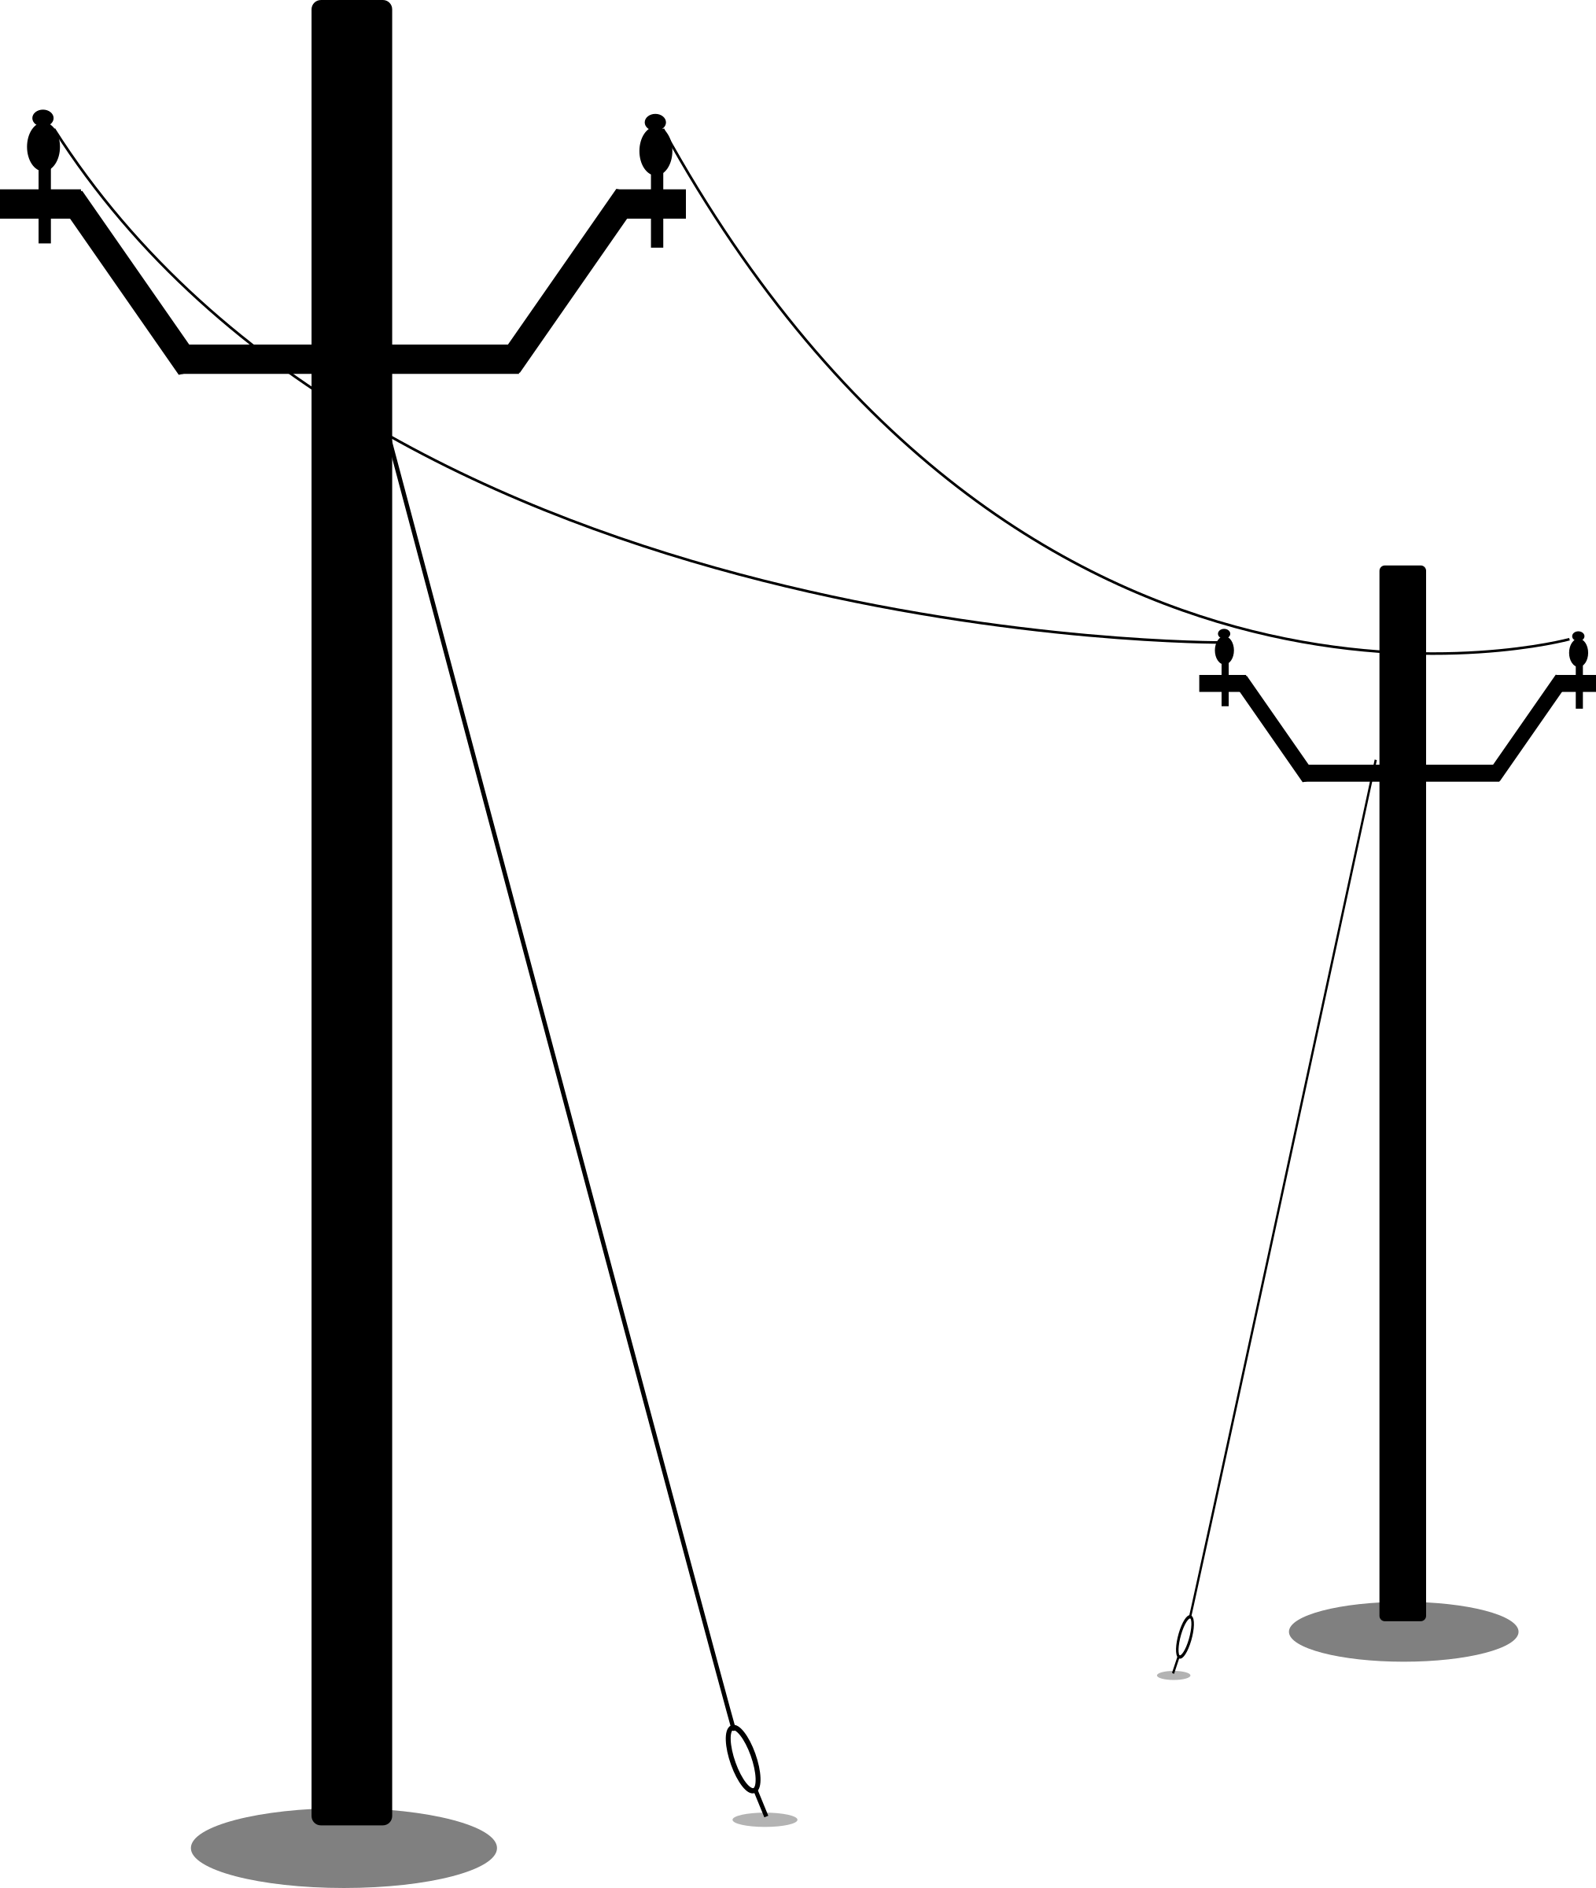
Notes:
Explain to students that you are going to introduce to them the eight energy stores.
Click:
Magnetic
The energy stored when like poles are pushed closer together or when unlike poles are pulled further apart.
(Fridge magnets, compasses and maglev trains which use magnetic levitation).
Click:
Thermal
In most cases this is the vibrations of the particles in the object. In hotter objects, the particles vibrate faster.
(The human body, hot coffees, stoves or hobs. Also: ice particles vibrate slower, but still have energy).
Click:
Chemical
The energy store associated with chemical bonds, such as those between molecules.
(Food, muscles, electrical cells).
Click:
Kinetic
The energy associated with a moving object.
(Runners, busses, comets).
Click:
Electrostatic (Electrical)
The energy stored when like charges are moved closer together or when unlike charges are pulled further apart.
(Thunderclouds, Van De Graaff generators).
Click:
Elastic
The energy stored when an object is stretched, squashed or twisted.
(Drawn catapults, compressed springs, inflated balloons).
Click:
Gravitational
The energy associated with an object at height.
(Aeroplanes, kites, mugs on a table).
Click:
Nuclear
The energy associated with nuclear interactions.
(Nuclear fusion of hydrogen and helium in the Sun, Uranium-245 undergoing fission).
Click (Next slide):

Slide 7
Notes:
Introduce to the students that there are two more energy stores that are represented by movement of energy.
Click:
Sound is a mechanical wave - acts as storage for both potential and kinetic energy.
When an object or surface is forced to move it vibrates releasing sound energy. Sound energy is a kinetic energy in the form of a wave.
Click:
Light is defined as a form of electromagnetic radiation – it is a kind of kinetic energy with the ability to make types of light visible to human eyes.
Light energy is also known as radiant energy and can come from the sun, a lightbulb, a glow-worm and even fire.
Click (Next slide):

Slide 8
Energy cannot
be created or
destroyed.
Notes:
Remind the students that energy cannot be created or destroyed.
You can now see that there are lots of ways to store energy to store the potential to do work.
As well as energy being stored it can be transferred but cannot be used up, that store of energy is not actually a physical thing.
Click (Next slide):

Slide 9
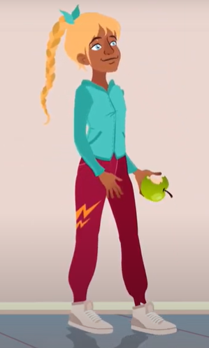
Energy is around
us all of the time.
Notes:
That ability to do work is a change in matter and we see that as movement all around us all of the time.
If you take a moment to look around, energy is present everywhere, cars move thanks to energy, and you get hot on a sunny day thanks to energy.
Click:
We can walk, run and jump, thanks to the energy we get from food.
Energy can't be lost or made the ability or potential to do work is transferred.
On a windy day the kinetic or movement energy that is in the air turns the blades of the wind turbine which transfers the ability to do work into electricity.
Electricity can pass all the way into our homes where it can be transferred by an electric heater into heat energy to warm us on a cold day.
Click (Next slide):

Slide 10
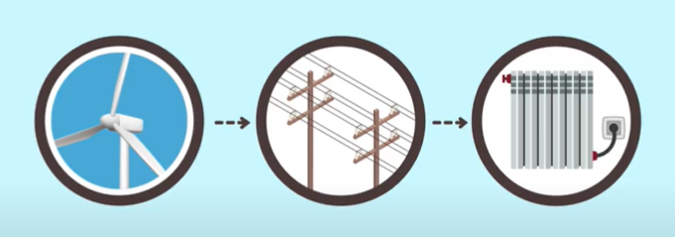
The ability or potential to do work is transferred.
Notes:
The ability or potential to do work is transferred.
On a windy day the kinetic or movement energy that is in the air turns the blades of the wind turbine which transfers the ability to do work into electricity.
Electricity can pass all the way into our homes where it can be transferred by an electric heater into heat energy to warm us on a cold day.
Click (Next slide):

Slide 11
Energy resources are the different ways of supplying the energy we need.
Notes:
Energy resources are the different ways of supplying the energy we need.
Our lives rely on more and more energy
Finding enough energy to power society now and in the future is a big challenge that engineers will have to solve.
Click (Next slide):

Slide 12
Renewable
Non-renewable
Notes:
Renewable/non-renewable
Renewable energy is energy that is collected from resources that will never run out or which are replaced by nature in less than a human lifetime.
Click:
Non-renewable energy is energy collected from resources that cannot be replaced when they are used up, such as oil, natural gas or coal.
Click (Next slide):

Slide 13
Activity time:
Notes:
You're now ready to complete task one, Energy Stores Table.
Click (Next slide):

Slide 14
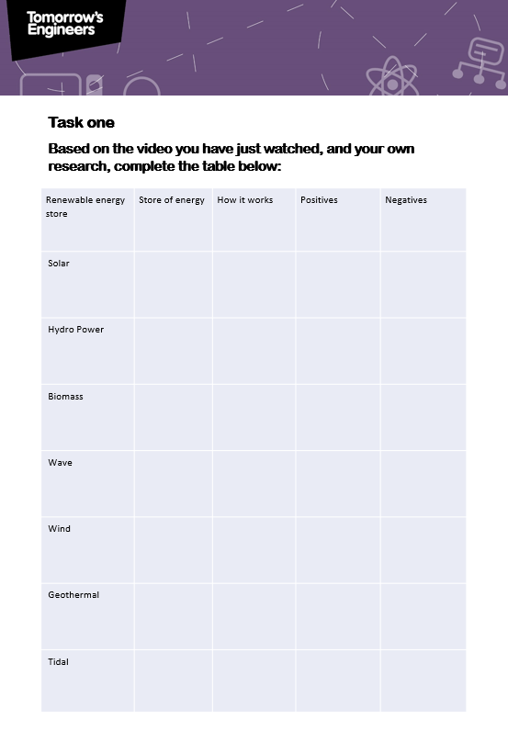
Using what you
know about
energy stores and
energy sources,
Notes:
Task one: Using what you know about energy stores and energy sources, and your own research from Part 2, “Why do We Need Engineers?” , complete the table on worksheet one.
Click (Next slide):

Slide 15
and your own
research from Part 2,
“Why do we need Engineers?”
Notes:
Task one: Using what you know now about energy stores and energy sources, and your own research from Part 2, “Why do We Need Engineers?” , complete the table on worksheet one.
Click (Next slide):

Slide 16
Complete the
table on
Activity One.
Notes:
Task one: Using what you know now about energy stores and energy sources, and your own research from Part 2, “Why do We Need Engineers?”, complete the table on worksheet one.
Click (Next slide):

Slide 17
Remember to come back
to Section 2 of Understand
Stores of Energy!

