Slide 1

Let’s watch an EUK Education case study!
Notes:
Instructions for teachers:
PowerPoint reflection activity
Divide your students into small groups and ask them to use the filters to find a case study of an engineer working in a sector that interests them. Then have them discuss one of the case studies and reflect on:
What was the main challenge addressed in the case study?
Why was it important to find a solution to this problem?
What positive impacts did the engineering solutions have?
What aspects of the engineers' work in the case study inspire you the most?
What did you learn from this case study about the role of engineers?
How has this case study influenced your thoughts about pursuing a career in engineering?
Find the case studies: Real jobs in engineering

Slide 2

What was the main challenge addressed in the case study?

Slide 3
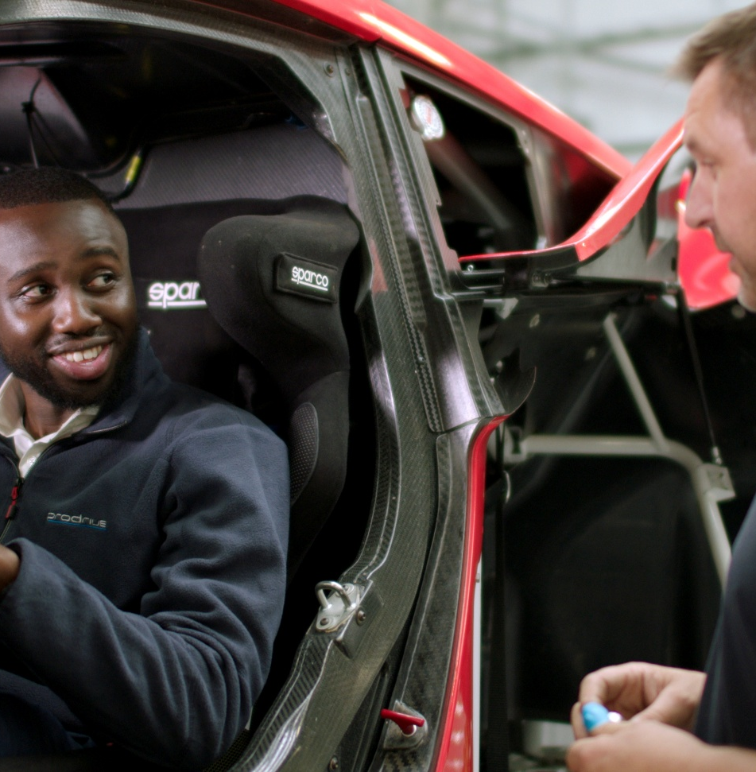
Why was it important to find a solution to this problem?

Slide 4

What positive impacts did the engineering solutions have?

Slide 5
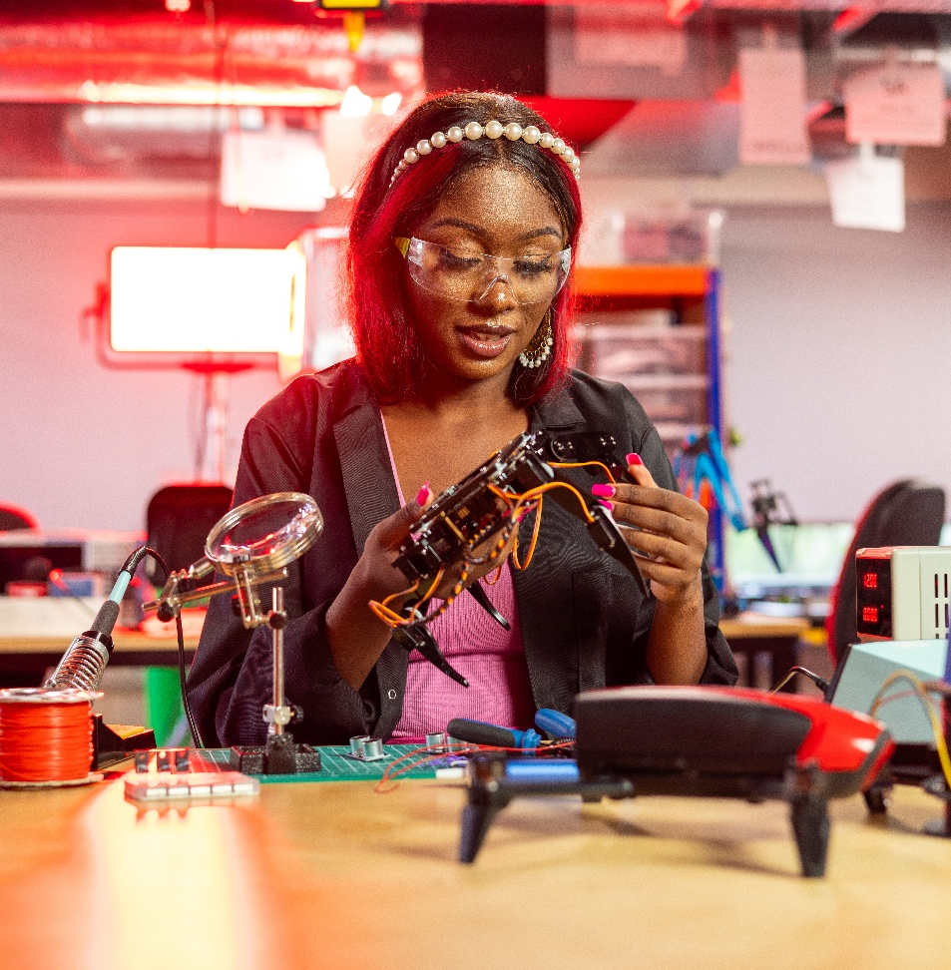
What aspects of the engineers' work in the case study inspire you the most?

Slide 6

What did you learn from this case study about what engineers do?

Slide 7

How has this case study influenced your thoughts about pursuing a career in engineering?

