Slide 1
An impact framework
for engineering outreach
Steph Neave, Head of Research
@_EngineeringUK

Slide 2
Aims of the project
Developing a shared vision, collective ownership and greater coordination
Provide a framework with which the sector is able to map activities and organisations against specific outcomes and stages within young people’s journeys – and in doing so, better assess the purpose of these activities/organisations and how they work together
Facilitate longer-term collaborative work to develop coordinated approaches to evaluation and impact measurement
A theoretical foundation to examine the collective and long-term impact of STEM outreach
Provide a basis for subsequent work to identify success indicators at critical stage of the conceptual journey and develop appropriate measures

Slide 3
Progress to date
Situation analysis (November 2019-January 2020)
Rapid evidence review
Interviews with expert stakeholders
Development of a theory of change (January – March 2020)
Three stakeholder workshops
Internal workshop and Board session
Assumption testing and refinement (September – December 2020)
Internal and external stakeholder consultations on draft framework

Slide 4
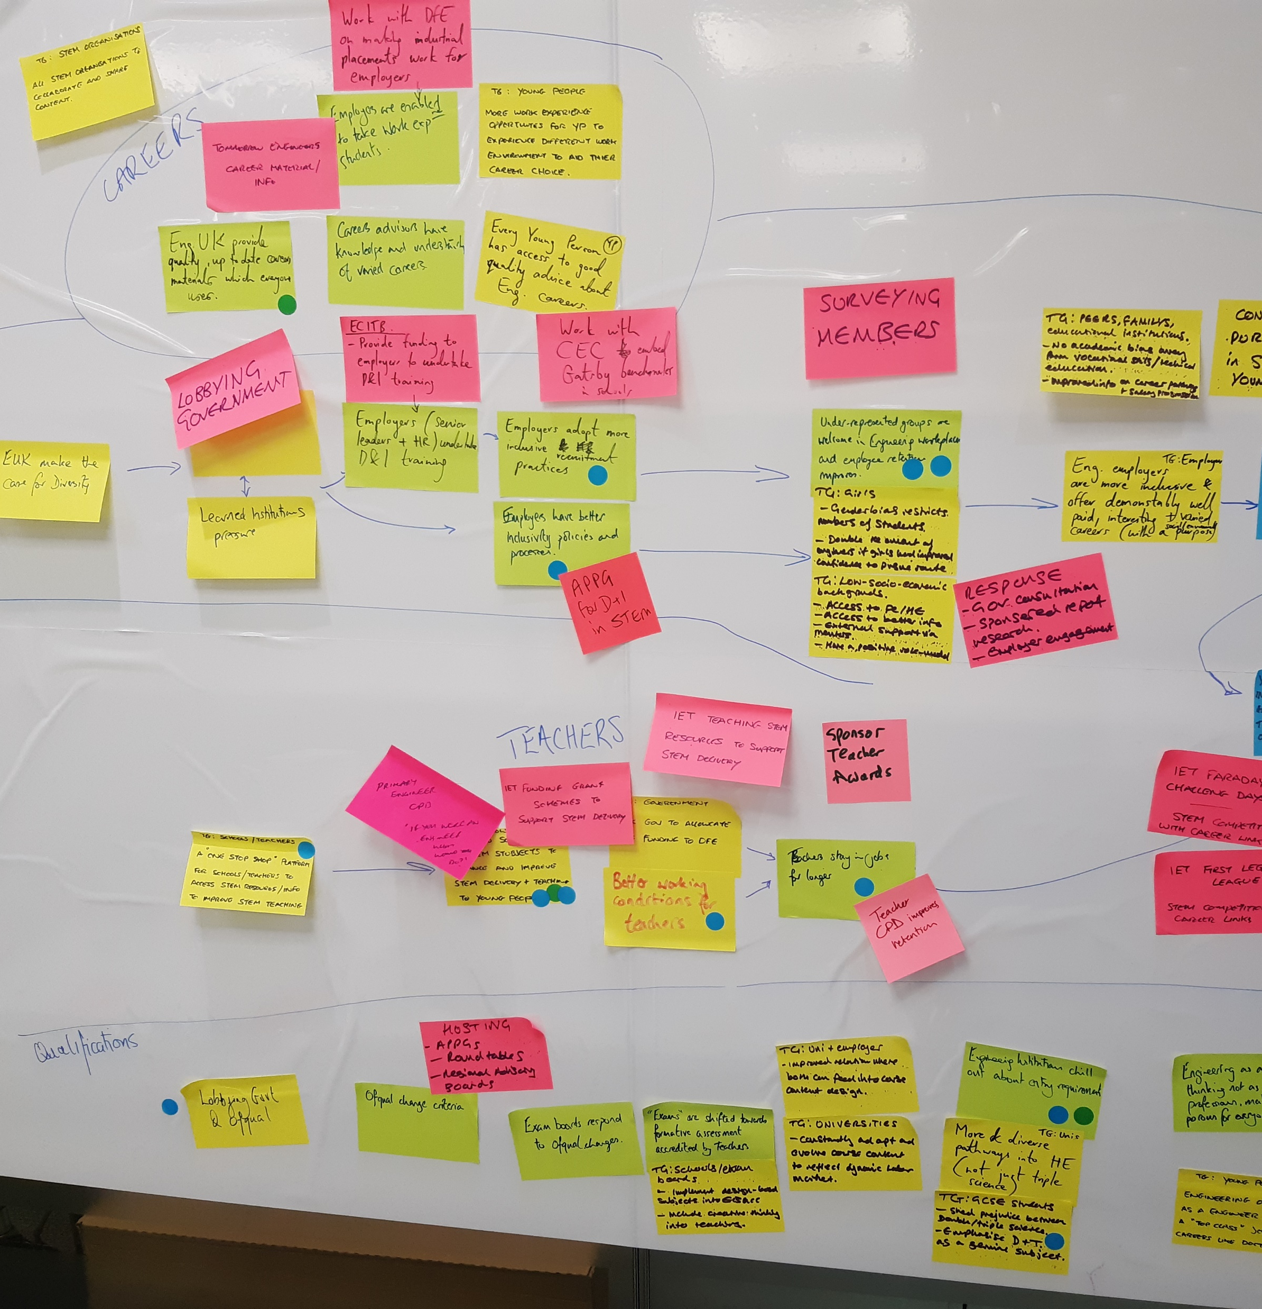
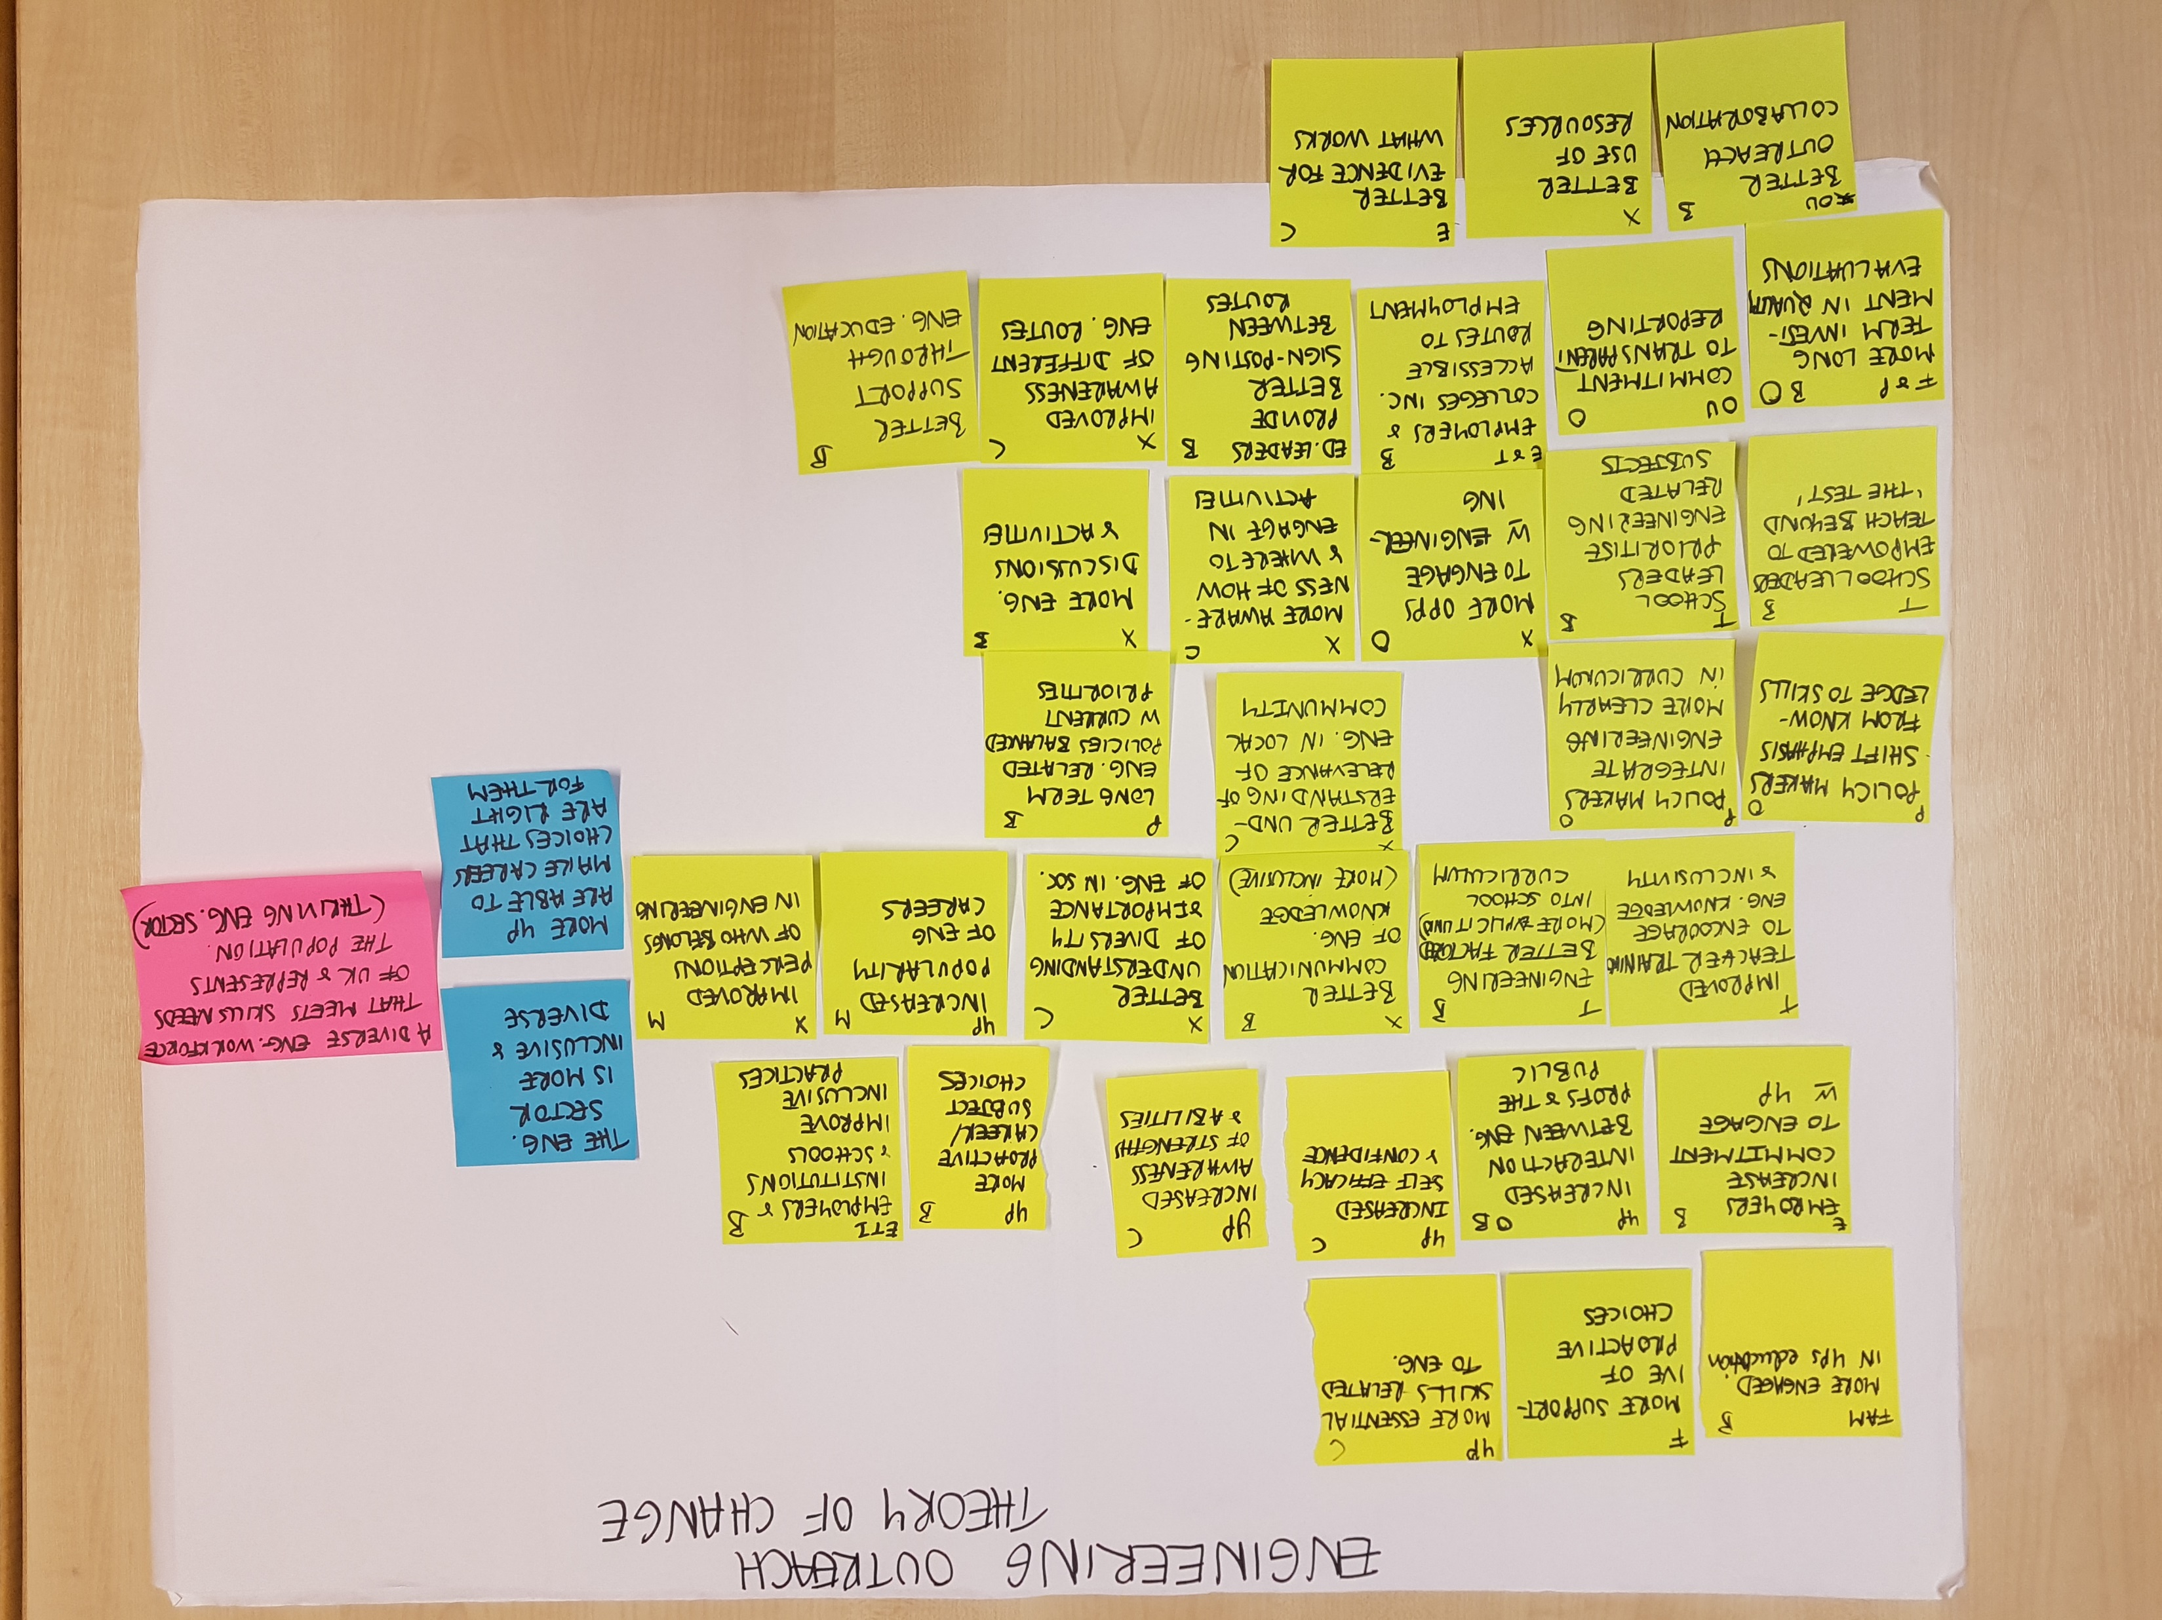
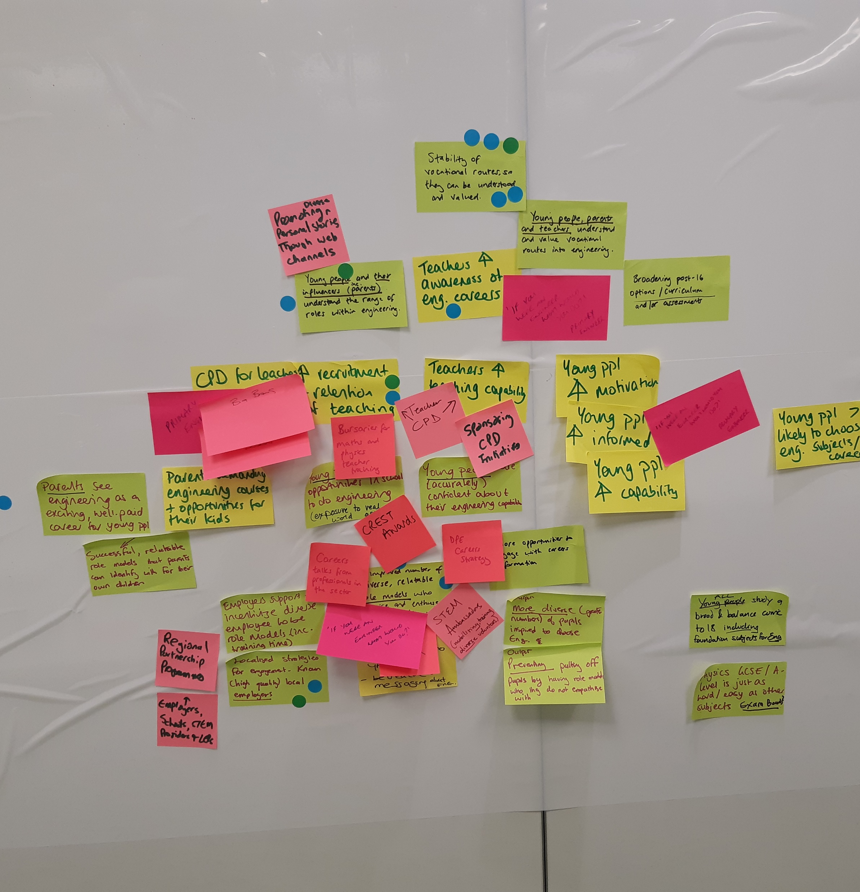
Progress to date

Slide 5
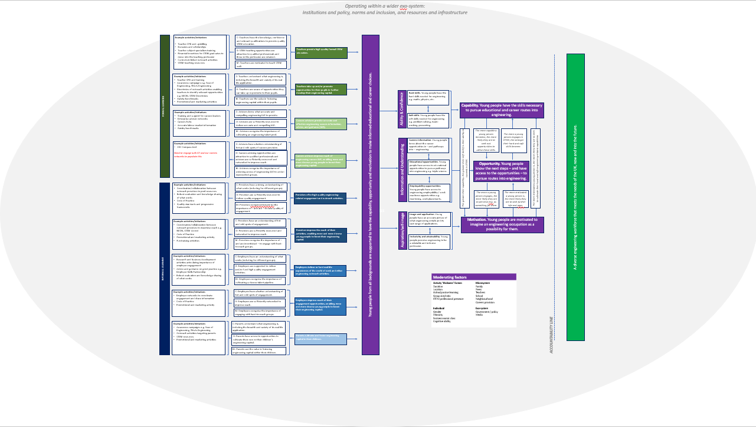

Slide 6
Defining what we mean by
‘impact’

Slide 7
What is the ultimate goal of
engineering outreach?
A diverse engineering workforce that meets the needs of the UK, now and into the future

Slide 8
Engineering outreach operates within a wider exo-system
The extent to which the UK is able to develop a diverse engineering workforce is affected by a range of forces, including institutions and policies, norms and inclusion, resources and infrastructure.
Media portrayals
A diverse engineering workforce that meets the needs of the UK, now and into the future
Engineering institutions
Government
Policy strategies
Perceptions and attitudes
Education leaders
Careers advisors
Labour market demand
Curriculum
Teachers
Employers
Parents
Teaching quality
Recruitment practices
Science and cultural capital

Slide 9
Given the huge amount of factors at play
– and the length of time that elapses from the time we engage a young person and they enter the workforce –
how do we measure impact?
A diverse engineering workforce that meets the needs of the UK, now and into the future
Eco-system of institutions and policies, norms and inclusion, resources and infrastructure

Slide 10
Increased number and diversity of young people choosing to study academic or vocational qualification in STEM subjects
A diverse engineering workforce that meets the needs of the UK, now and into the future
What is in our power to influence and measure?
Eco-system of institutions and policies, norms and inclusion, resources and infrastructure

Slide 11
Increased number and diversity of young people choosing to study academic or vocational qualification in STEM subjects
A diverse engineering workforce that meets the needs of the UK, now and into the future
What is in our power to influence and measure?
Eco-system of institutions and policies, norms and inclusion, resources and infrastructure
ACCOUNTABILITY LINE

Slide 12
Increased number and diversity of young people choosing to study academic or vocational qualification in STEM subjects
A diverse engineering workforce that meets the needs of the UK, now and into the future
What is in our power to influence and measure?
Young people are supported to have the capability, opportunity and motivation to make an informed choice as to whether to pursue an engineering career – and more choose to do so
Eco-system of institutions and policies, norms and inclusion, resources and infrastructure
ACCOUNTABILITY LINE

Slide 13
Increased number and diversity of young people choosing to study academic or vocational qualification in STEM subjects
A diverse engineering workforce that meets the needs of the UK, now and into the future
What is in our power to influence and measure?
COM-B is a behavioural change approaches often used in theory of change models.
Underpinning the approach is the belief that at any given moment, a particular behaviour will occur only when the person concerned has the capability and opportunity to engage in the behaviour and is more motivated to enact that behaviour than any other behaviours​.
Young people are supported to have the capability, opportunity and motivation to make an informed choice as to whether to pursue an engineering career – and more choose to do so
ACCOUNTABILITY LINE

Slide 14
n
Capability. Young people have the skills necessary to pursue educational and career routes into engineering.
Increased number and diversity of young people choosing to study academic or vocational qualification in STEM subjects
A diverse engineering workforce that meets the needs of the UK, now and into the future
The more capable a young person becomes, the more likely they are to seek out opportunities to utilise these skills.
The more motivated a young person is, the more likely they are to seek to cultivate their hard and soft engineering-related capabilities.
The more a young person engages in STEM, the stronger their hard and soft skills become.
Young people are supported to have the capability, opportunity and motivation to make an informed choice as to whether to pursue an engineering career – and more choose to do so
Opportunity. Young people know the next steps – and have access to the opportunities – to pursue routes into engineering.
The more a young person engages, the more likely they are to perceive eng. as something for them.
The more motivated a young person is, the more likely they are to seek further info and opportunities.
The greater their capability, the greater their self-belief in their ability to succeed in STEM.
ACCOUNTABILITY LINE
Motivation. Young people are motivated to imagine an engineering occupation as a possibility for them.

Slide 15
Identifying the ‘intermediate outcomes’ to achieve this goal

Slide 16
Outcomes
Impact
Long-term
End goal
Ability and Confidence
Young people are supported to have the capability, opportunity and motivation to make an informed choice as to whether to pursue an engineering career – and more choose to do so
Increased number and diversity of young people choosing to study academic or vocational qualification in STEM subjects
Capability (Perceived and actual)
Young people feel they have – and can use – the skills needed to succeed in engineering.
Hard skills
Young people gain the hard skills needed for engineering e.g. maths, physics.
Soft skills
Young people gain the soft skills needed for engineering e.g. problem-solving, team-working.
Opportunity (Take up and application)
A diverse engineering workforce that meets the needs of the UK, now and into the future
Motivation (Confidence to aspire)
ACCOUNTABILITY LINE

Slide 17
Outcomes
Impact
Long-term
End goal
Ability and Confidence
Young people are supported to have the capability, opportunity and motivation to make an informed choice as to whether to pursue an engineering career – and more choose to do so
Increased number and diversity of young people choosing to study academic or vocational qualification in STEM subjects
Capability (Perceived and actual)
Young people feel they have – and can use – the skills needed to succeed in engineering.
Hard skills
Young people gain the hard skills needed for engineering e.g. maths, physics.
Soft skills
Young people gain the soft skills needed for engineering e.g. problem-solving, team-working.
Information and Understanding
Opportunity (Take up and application)
Young people have an appreciation for what engineering is and the related educational and career opportunities available to them.
Image and application
Young people have an accurate picture of what eng. entails and its vast range of applications.
Careers information
Young people are aware of and able to access eng. careers info and employer encounters.
Educational opportunities
Young people are aware of and able to access ed. opportunities to pursue pathways into engineering.
A diverse engineering workforce that meets the needs of the UK, now and into the future
Motivation (Confidence to aspire)
ACCOUNTABILITY LINE

Slide 18
Outcomes
Impact
Long-term
End goal
Ability and Confidence
Young people are supported to have the capability, opportunity and motivation to make an informed choice as to whether to pursue an engineering career – and more choose to do so
Increased number and diversity of young people choosing to study academic or vocational qualification in STEM subjects
Capability (Perceived and actual)
Young people feel they have – and can use – the skills needed to succeed in engineering.
Hard skills
Young people gain the hard skills needed for engineering e.g. maths, physics.
Soft skills
Young people gain the soft skills needed for engineering e.g. problem-solving, team-working.
Information and Understanding
Opportunity (Take up and application)
Young people have an appreciation for what engineering is and the related educational and career opportunities available to them.
Image and application
Young people have an accurate picture of what eng. entails and its vast range of applications.
Careers information
Young people are aware of and able to access eng. careers info and employer encounters.
Educational opportunities
Young people are aware of and able to access ed. opportunities to pursue pathways into engineering.
A diverse engineering workforce that meets the needs of the UK, now and into the future
Aspiration and Self-Image
Motivation (Confidence to aspire)
Young people feel confident that an engineering career is for ‘people like them’ and can aspire to such a career.
Inclusivity
Young people perceive eng. to be a relatable and inclusive profession for them.
Desirability
Young people perceive engineering to be an appealing career choice for them.
ACCOUNTABILITY LINE

Slide 19
Who has the power to influence young people’s capabilities, opportunities, and motivation to pursue engineering?

Slide 20
Actors
Outcomes
Impact
Long-term
End goal
Who are the main actors that can influence young people’s capabilities, opportunities, and motivations in the formal and informal learning settings?
Note: for the purposes of this exercise, we decided to restrict actors to those within a young person’s immediate eco-system – and for that reason have excluded e.g. government.
FORMAL LEARNING
Teachers
Young people are supported to have the capability, opportunity and motivation to make an informed choice as to whether to pursue an engineering career – and more choose to do so
Increased number and diversity of young people choosing to study academic or vocational qualification in STEM subjects
Capability
Hard skills
Careers advisors
Soft skills
Opportunities
Image and application
INFORMAL LEARNING
Outreach providers
Careers information
A diverse engineering workforce that meets the needs of the UK, now and into the future
Educational opportunities
Employers or funders
Motivation
Youth groups and clubs
Inclusivity
ACCOUNTABILITY LINE
Desirability
Parents
Social media

Slide 21
Actors
Outcomes
Impact
Long-term
End goal
FORMAL LEARNING
Teachers
Young people are supported to have the capability, opportunity and motivation to make an informed choice as to whether to pursue an engineering career – and more choose to do so
Increased number and diversity of young people choosing to study academic or vocational qualification in STEM subjects
Capability
Hard skills
Careers advisors
Soft skills
In what ways can these actors positively affect our impact goal?
Our impact goal implies there are two dimensions:
Raising quality
By improving reach
Opportunities
Image and application
INFORMAL LEARNING
Outreach providers
Careers information
A diverse engineering workforce that meets the needs of the UK, now and into the future
Educational opportunities
Employers or funders
Motivation
Youth groups and clubs
Inclusivity
ACCOUNTABILITY LINE
Desirability
Parents
Social media

Slide 22
Actors
Outcomes
Impact
Long-term
End goal
Young people are supported to have the capability, opportunity and motivation to make an informed choice as to whether to pursue an engineering career – and more choose to do so
Increased number and diversity of young people choosing to study academic or vocational qualification in STEM subjects
TEACHERS
Capability
Hard skills
In what ways can these actors positively affect our impact goal?
Our impact goal implies there are two dimensions:
Raising quality
By improving reach
Teachers provide high quality formal STEM education
Soft skills
Opportunities
Image and application
Teachers take up or promote opportunities for pupils to develop their eng. capital
Careers information
A diverse engineering workforce that meets the needs of the UK, now and into the future
Educational opportunities
Motivation
Inclusivity
ACCOUNTABILITY LINE
Desirability

Slide 23
Actors
Outcomes
Impact
Long-term
End goal
Young people are supported to have the capability, opportunity and motivation to make an informed choice as to whether to pursue an engineering career – and more choose to do so
Increased number and diversity of young people choosing to study academic or vocational qualification in STEM subjects
EMPLOYERS OR FUNDERS
Capability
Hard skills
In what ways can these actors positively affect our impact goal?
Our impact goal implies there are two dimensions:
Raising quality
By improving reach
Employers deliver or fund real life experiences of the world of engineering
Soft skills
Opportunities
Image and application
Careers information
Employers improve reach of engagement to more and more diverse young people
A diverse engineering workforce that meets the needs of the UK, now and into the future
Educational opportunities
Motivation
Inclusivity
ACCOUNTABILITY LINE
Desirability

Slide 24
Actors
Outcomes
Impact
Long-term
End goal
FORMAL LEARNING
Teachers
Young people are supported to have the capability, opportunity and motivation to make an informed choice as to whether to pursue an engineering career – and more choose to do so
Increased number and diversity of young people choosing to study academic or vocational qualification in STEM subjects
These actors, in turn, must have the capability, opportunity, and motivation to improve the reach and quality of their activities.
Much of our community’s work contributes indirectly to our end goal by ensuring teachers, careers advisors, providers, employers and parents are supported.
Capability
Hard skills
Careers advisors
Soft skills
Opportunities
Image and application
INFORMAL LEARNING
Outreach providers
Careers information
A diverse engineering workforce that meets the needs of the UK, now and into the future
Educational opportunities
Employers or funders
Motivation
Youth groups and clubs
Inclusivity
ACCOUNTABILITY LINE
Desirability
Parents
Social media

Slide 25
Young people outcomes
Impact
Long-term
End goal
Teachers
Young people are supported to have the capability, opportunity and motivation to make an informed choice as to whether to pursue an engineering career – and more choose to do so
Increased number and diversity of young people choosing to study academic or vocational qualification in STEM subjects
Capability
Example activities and initiatives
Teacher CPD and upskilling
Bursaries and scholarships
Teacher subject specialism training
Financial incentives for STEM graduates to move into the teaching profession
Curriculum-linked outreach
STEM teaching resources
C: Teachers have the knowledge, confidence and experience to provide quality STEM education that fosters hard & soft skills.
QUALITY
Teachers provide high quality formal STEM education
Hard skills
Soft skills
O: STEM teaching opportunities are attractive to qualified professionals and those in the profession are retained.
Opportunities
M: Teachers are incentivised and supported to provide high quality STEM education that fosters hard & soft skills.
Image and application
Careers information
A diverse engineering workforce that meets the needs of the UK, now and into the future
Teachers take up or promote opportunities for pupils to develop their engineering
capital
Educational opportunities
Example activities and initiatives
Teacher CPD and training
Awareness campaigns e.g. Year of Engineering, TiE
Directories of outreach activities enabling teachers to identify relevant opportunities e.g. NEON
Promotional and marketing activities
C: Teachers understand what engineering is, including the breadth and variety of its real life application.
REACH
Motivation
O: Teachers are aware of opportunities they can take up or promote to their pupils.
Inclusivity
ACCOUNTABILITY LINE
Desirability
M: Teachers see the value in fostering engineering capital within their pupils.

Slide 26
Young people outcomes
Impact
Long-term
End goal
Careers advisors
Young people are supported to have the capability, opportunity and motivation to make an informed choice as to whether to pursue an engineering career – and more choose to do so
Increased number and diversity of young people choosing to study academic or vocational qualification in STEM subjects
Capability
Example activities or
initiatives
Training and support for careers leaders
Enterprise advisor networks
Careers hubs
Labour market information
Gatsby benchmarks
C: Advisors know what accurate and compelling engineering IAG to provide.
QUALITY
Advisors provide
accurate & effective engineering careers information, advice, and guidance (IAG)
Hard skills
Soft skills
O: Careers advising opportunities are attractive to qualified professionals.
Opportunities
M: Advisors recognise the importance of cultivating an engineering talent pool.
Image and application
Careers information
A diverse engineering workforce that meets the needs of the UK, now and into the future
Example activities or initiatives
CEC Compass tool
Careers working groups
C: Advisors are able to identify where and for whom there are gaps in careers provision.
Advisors improve reach of engineering careers IAG, enabling more and more diverse young people to boost their engineering capital
REACH
Educational opportunities
O: Advisors are sufficiently resourced and networked to improve reach.
Motivation
Inclusivity
ACCOUNTABILITY LINE
Desirability
M: Advisors recognise the importance of widening access of engineering IAG to underrepresented groups.

Slide 27
Young people outcomes
Impact
Long-term
End goal
Providers
Young people are supported to have the capability, opportunity and motivation to make an informed choice as to whether to pursue an engineering career – and more choose to do so
Increased number and diversity of young people choosing to study academic or vocational qualification in STEM subjects
Example activities and initiatives
Collaboration between outreach providers to pool resources e.g. coalition
Robust evaluation and knowledge sharing of what works e.g. Tomorrow’s Engineers
Code of Practice
Quality standards and progression frameworks
QUALITY
C: Providers have a strong understanding of what works (including for different groups).
Providers offer high quality engineering-related engagement and outreach activities
Capability
Hard skills
O: Providers are sufficiently resourced to deliver quality engagement and opportunities to do so are attractive to qualified professionals.
Soft skills
Opportunities
Image and application
M: Providers recognise the importance of – and are incentivised – to raise quality of engagement.
Careers information
A diverse engineering workforce that meets the needs of the UK, now and into the future
Educational opportunities
Providers improve the reach of their activities, enabling more and more diverse young people to boost their engineering capital
Example activities and initiatives
Collaboration between outreach providers to maximise reach e.g. NEON, STEM Accord
Code of Practice
Promotional and marketing activity
Fundraising activities
C: Providers have an understanding of hot and cold spots of engagement.
REACH
Motivation
O: Providers are sufficiently resourced and networked to improve reach.
Inclusivity
ACCOUNTABILITY LINE
Desirability
M: Providers recognise the importance of – and are incentivised – to engage w/ underrepresented groups.

Slide 28
Young people outcomes
Impact
Long-term
Youth groups and clubs
End goal
Young people are supported to have the capability, opportunity and motivation to make an informed choice as to whether to pursue an engineering career – and more choose to do so
Increased number and diversity of young people choosing to study academic or vocational qualification in STEM subjects
Capability
Hard skills
Soft skills
For further development
Opportunities
Image and application
Careers information
A diverse engineering workforce that meets the needs of the UK, now and into the future
Educational opportunities
Motivation
Inclusivity
ACCOUNTABILITY LINE
Desirability

Slide 29
Young people outcomes
Impact
Long-term
Employers or funders
End goal
Young people are supported to have the capability, opportunity and motivation to make an informed choice as to whether to pursue an engineering career – and more choose to do so
Increased number and diversity of young people choosing to study academic or vocational qualification in STEM subjects
C: Employers have an understanding of what works (including for different groups).
QUALITY
Example activities/initiatives
Research and business development activities articulating importance of employer engagement
Advice and guidance on good practice
Robust evaluation and knowledge sharing of what works
Employers deliver or fund real life experiences of the world of work and other engineering outreach activities
Capability
Hard skills
O: Employers are supported to deliver and/or fund high quality engagement activities.
Soft skills
Opportunities
M: Employers recognise the importance of cultivating a diverse talent pipeline.
Image and application
Careers information
A diverse engineering workforce that meets the needs of the UK, now and into the future
Example activities/initiatives
Employer networks to coordinate engagement and share information
Code of Practice
Promotional and marketing activity
Employers improve reach of their engagement opportunities, enabling more and more diverse young people to boost their engineering capital
C: Employers have a better understanding of hot and cold spots of engagement.
REACH
Educational opportunities
Motivation
O: Employers are sufficiently networked to improve reach.
Inclusivity
ACCOUNTABILITY LINE
Desirability
M: Employers recognise the importance of engaging w/ underrepresented groups.

Slide 30
Young people outcomes
Impact
Long-term
Parents
End goal
Young people are supported to have the capability, opportunity and motivation to make an informed choice as to whether to pursue an engineering career – and more choose to do so
Increased number and diversity of young people choosing to study academic or vocational qualification in STEM subjects
Capability
Hard skills
Example activities/initiatives
Awareness campaigns e.g. Year of Engineering, TiE
Outreach activities targeting parents
STEM resources
Promotional and marketing activities
C: Parents understand what engineering is, including the breadth and variety of its real life application.
Parents cultivate and foster engineering capital in their children
Soft skills
Opportunities
O: Parents have access to opportunities to cultivate their own or their children’s engineering capital.
Image and application
Careers information
M: Parents see the value in fostering engineering capital within their children.
A diverse engineering workforce that meets the needs of the UK, now and into the future
Educational opportunities
Motivation
Inclusivity
ACCOUNTABILITY LINE
Desirability

Slide 31
Young people outcomes
Impact
Long-term
Social media
End goal
Young people are supported to have the capability, opportunity and motivation to make an informed choice as to whether to pursue an engineering career – and more choose to do so
Increased number and diversity of young people choosing to study academic or vocational qualification in STEM subjects
Capability
Hard skills
Soft skills
Beyond current scope of framework
Opportunities
Image and application
Careers information
A diverse engineering workforce that meets the needs of the UK, now and into the future
Educational opportunities
Motivation
Inclusivity
ACCOUNTABILITY LINE
Desirability

Slide 32
Putting it all together …

Slide 34
Moderating factors
Activity ‘thickness’ factors Duration Location Active/passive learning Group size/ratio STEM professional presence Individual Gender Ethnicity Socioeconomic class Cognitive ability | Microsystem Family Peers Teachers School Neighbourhood Careers provision Exo-system Government / policy Media

Slide 35
‘Take home’ point 1
A multi-faceted issue requires a multi-faceted solution. Over the course of their lifetime, young people are influenced by a multitude of factors and actors that together affect their educational and career choices. As a community, we should therefore:
seek to support young people on a range of dimensions (e.g. fostering their capability, opportunity, and motivation)
work to engage young people multiple times over their lifetime

Slide 36
‘Take home’ point 2
No one organisation will be able to single-handedly increase the number and diversity of young people entering engineering. With this in mind, we need to:
consider the wider ecosystem of effort when planning and delivering our own activities
work together as a community to share insights, learn from one another, and identify where more targeted work is needed

Slide 37
‘Take home’ point 3
With so many factors at play, measuring our own individual impact on such a long-term goal can be difficult, if not impossible.
It may be more helpful to instead consider how our respective actions contribute to our overarching goal by facilitating intermediate outcomes that support young people in their decision-making processes. Honing in on these specific objectives enables more robust evaluation of our work, since we can be more concrete about what constitutes success and how we go about measuring it.

Slide 38
What’s next?
Framework published in early 2021 – a ‘living document’
Bank of measures released in Spring 2021 and updated on an ongoing basis
Good practice guidance on evaluation published periodically on https://www.tomorrowsengineers.org.uk/

Slide 39
Questions?
For more information, visit www.engineeringuk.com/research
For questions, email sneave@engineeringuk.com
@_EngineeringUK

